Slide 1
Python Deeper Dive Intro to Git
Lesson 3.3

Slide 2
Version Control Systems in General
Git
Commits
Big picture
How-to
Branching
Big picture
How-to
Remote Repositories
Big picture
How-to

Slide 3
Version Control Systems

Slide 4

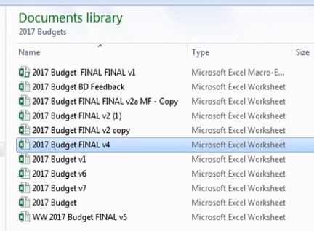
The Problem: Keeping Track of Work History Is Hard!
Worse when you consider that:
People may need to work on something at the same time
And often in different locations
Over the lifetime of a project, it may not even be the same people

Slide 5

Version control systems are software that help you track changes you make in your code over time. As you edit your code, you tell the version control system to take a snapshot of your files. The version control system saves that snapshot permanently so you can recall it later if you need it.
—Microsoft

Slide 6
GitHub Commits
Git works in commits
Git thinks of project history as a series of snapshots or checkpoints. The Git term for this is commits.
When you’re ready to save your work, it’s said that you can “make a commit,” “commit your files,” or just “commit.” Think of this as taking a snapshot of your entire project, aka repository.
In the future, you can always go back to previous commits, no matter what you’ve done to your code in the meantime.

Slide 7

GitHub
Git is a version control system. For our class, we will be using GitHub as the hosting service for our Git repositories.

Slide 8
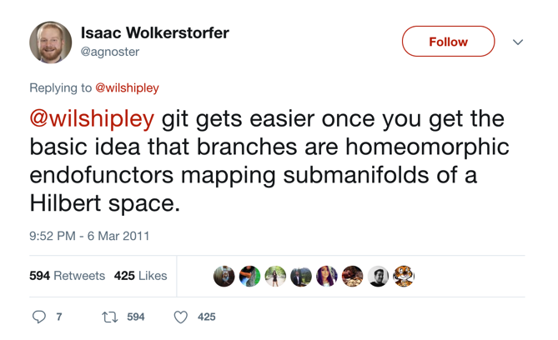
Using Git on GitHub
It’s not this bad, but Git is known for having a bit of a learning curve.

Slide 9
GitHub Commits

Slide 10

GitHub Commits
Other metaphors
Reaching a checkpoint in a video game
Time Machine on Mac (or other backups)
Saving a v37 (except more sophisticated)
Notes:
shutterstock_1170546082

Slide 11

GitHub Commits
Another way to think about a commit

Slide 12
GitHub Commits
A project is just a series of commits
Commit 0
Commit 1
Commit 2
Wrote a readme!
Wrote most of the code
Added tests

Slide 13
GitHub Branching

Slide 14
GitHub Branches
All commits live on branches
The default, or main, branch is typically called the master branch.
However, you can have many branches.
For example, you might start a feature branch in order to work on a new experimental feature. If we’re working on issue #53 in our backlog, let’s call the branch “iss53”.
master
C0
C1
C2

Slide 15
GitHub Branches
At first, our branch and the master branch look exactly the same:
Then, maybe we’ll do some work and make a commit on the “iss53” branch. Then it will look like this:
master
C0
C1
C2
iss53
master
C0
C1
C2
C3
iss53

Slide 16
GitHub Branches
In simple cases, once we’ve finished working on the feature branch, we’ll be ready to merge it back into the master branch. Then we can get rid of the feature branch because the master branch will now contain all of the commit information.
master
C0
C1
C2
C1
master

Slide 17
Branching may not seem that important now. However, it is foundational for more complex workflows and for working with other people on the same project. For now, remember that branching is a useful way to work on separate parts of the project at the same time.

Slide 18
GitHub Remote Repositories

Slide 19




GitHub Remote Repositories
So far, we’ve been talking only about the local environment—that is, a local repository on your computer
</>
Remote repository on GitHub.com
Engineer's Machine
Engineer's Machine
Engineer's Machine
Engineer's Machine
</>
</>
</>
</>
Local clone of repository
Local clone of repository
Local clone of repository
Local clone of repository

Slide 20
Git really starts to shine when you have multiple workers on their own machines trying to sync code to a remote repository that is hosted on another machine accessible to everybody (e.g., on the Internet or some other network).

Slide 21
GitHub Remote Repositories
In many workflows, the remote repository serves as an even-more-central master branch. A typical workflow consists of the following:
Sync your local repo with the remote repo to get the most up-to-date version of the code.
Create a feature branch.
Do some work.
Commit your changes.
Merge your feature branch into your local master.
Push your local master to the remote master.
Now everyone has access to the code you just wrote.

Slide 22
Additional Git and GitHub Resources
Git-scm.com
Recompilermag.com
slideshare.net

